Slide 1




MPHASIS FOUNDATION
PASSENGER RE-ACCOMODATION PROBLEM
FOR A PLANNED SCHEDULED CHANGE
TEAM-69

Slide 2



TABLE OF CONTENT
PROBLEM BACKGROUND
PROBLEM DESCRIPTION
DATASET
PREPROCESSING
PROPOSED SOLUTION
PROPOSED ALGORITHM
GRAPH BASED APPROACH
ILP APPROACH

Slide 3
PROBLEM BACKGROUND
Airlines frequently adjust their flight schedules for various reasons, such as adapting to seasonal demands, exploring new routes, accommodating daylight savings time changes, and modifying flight details like numbers, frequencies, and timings.
These schedule adjustments can significantly affect passengers, necessitating their re-accommodation onto alternative flights.
To address this challenge, airlines require a solution that can systematically analyze the impact of schedule changes on passengers and automatically identify suitable alternate flights for those affected.

Slide 4
PROBLEM DESCRIPTION
Challenge
Efficiently identifying optimal alternate flight solutions for passengers affected by planned schedule changes in the airline industry.
Rule Set Enforcement
Meticulous enforcement of rule sets
Integration as optimization constraints during solution generation or pre/post-process calculations
Ranking Criteria
A comprehensive ranking system is sought.
Factors include time to destination and impact on purchased ancillary services.
Passenger Priority Ranking
Establishing a system for prioritizing re-accommodation
Factors: passenger type, loyalty levels, paid class of service

Slide 5
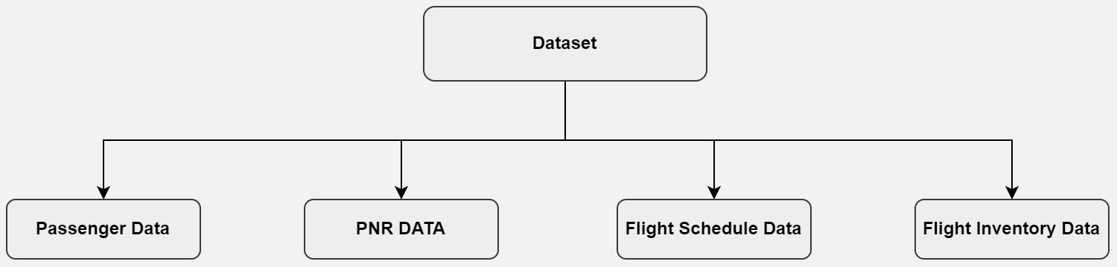
DATASET DESCRIPTION
Within the dataset,there are four essential files: the Passenger Dataset, PNR Dataset,Flight Schedule Dataset, and Flight Inventory Dataset.

Slide 6
PREPROCESSING
Prior to initiating the algorithm, we adhered to five crucial steps:
Selection of Affected PNRs List
Identification of Possible Flights for Re accommodation
Integration of Schedule Dataset with Inventory Dataset
Flight Ranking
PNR Ranking

Slide 7
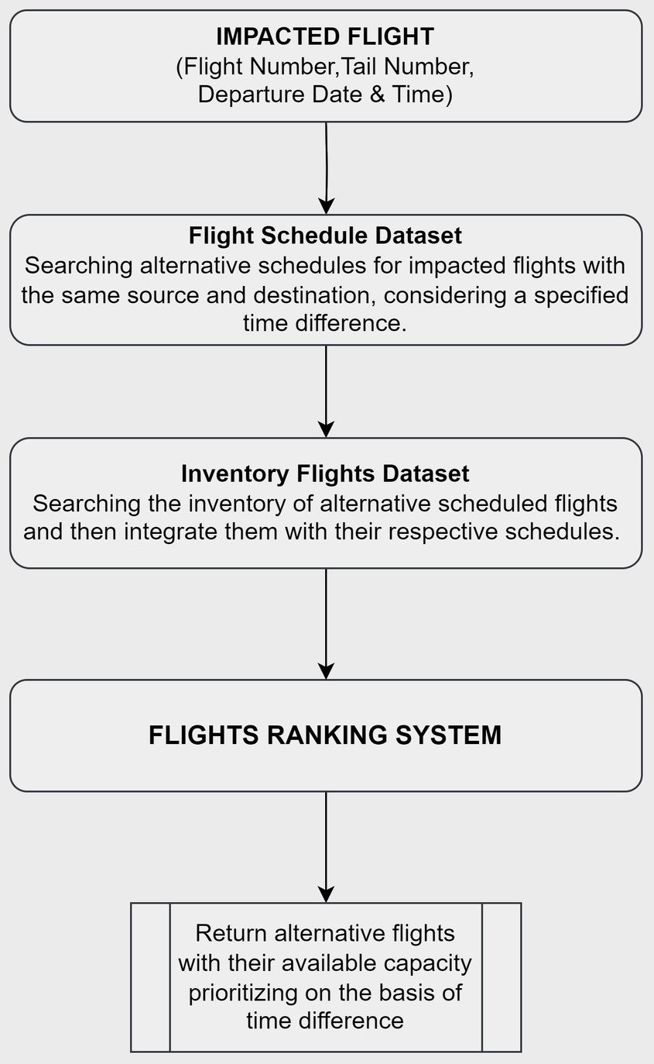
FLIGHT RANKING

Slide 8
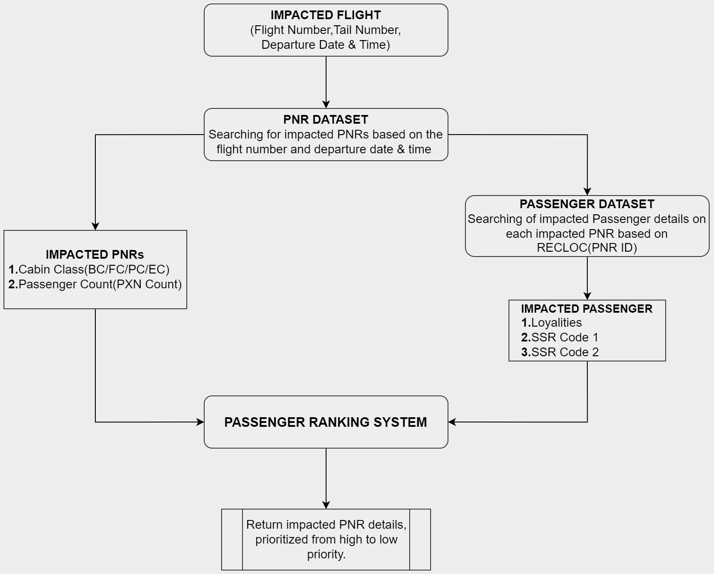
PNR RANKING

Slide 9
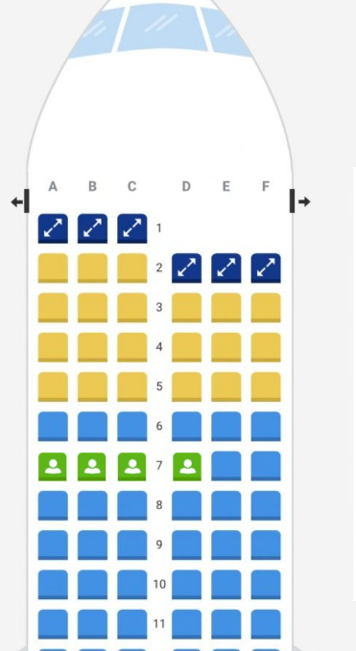
PROPOSED SOLUTION
Knapsack Similarity:
To optimally allocate passengers to flights with varying seat capacities and ensure passengers under the same PNRs travel together, we adapted the 0-1 Knapsack algorithm.
Enables efficient use of available seats, addressing the challenge of allocating passengers effectively across different flights while maintaining PNR cohesion.

Slide 10
FLIGHT-PRIORITY ALLOCATION
Systematic allocation process prioritizing flights
Consideration of individual flight constraints and seat availability
Utilization of the knapsack algorithm for optimization
Iterative application for each class, ensuring the best fit
Consideration of upgraded/downgraded class allocations based on predefined rules
Deferral of unallocated passengers for subsequent flights if necessary.
Flexibility to neglect class-wise allocation in certain cases for efficiency.

Slide 11
CLASS-PRIORITY ALLOCATION
Systematic seat allocation for each cluster of Passenger Name Records (PNRs) belonging to the same class
Prioritization of original class allocation for each PNR cluster
Utilization of the knapsack solution for algorithmically sound seat allocation
Consideration of subsequent flights if the desired class is unavailable in the initial flight
Maximum consideration window of 6 hours for exploring subsequent flights
Enhancement of overall efficiency in the re-accommodation task through algorithmic approaches.

Slide 12
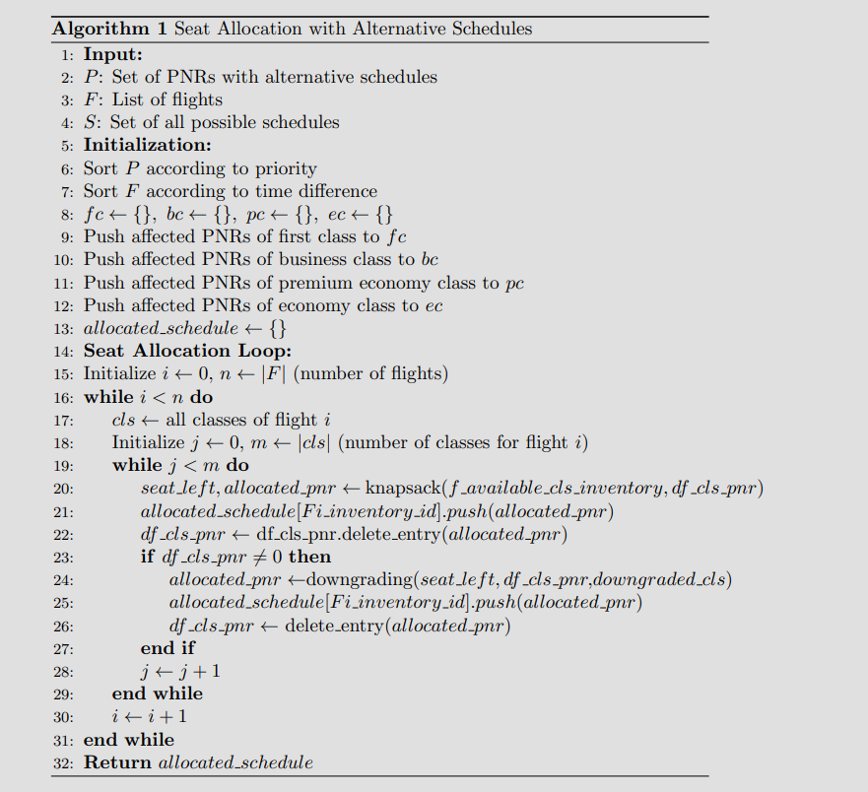
ALGORITHM

Slide 13
SOLUTION APPROACHES
One-One | Single Impacted Flight - Simple Solution
One-Multi | Single Impacted Flight - Multi-Flight Solution
Multi-One | Impacted Flight + Downline Flight - Single Flight Replacement
Multi-Multi | Impacted Flight + Downline Flight - Multi-Flight Replacement

Slide 14
GRAPH BASED APPROACH
Used For Generating Reaccomodation schemas for 1-Multi and Multi-Multi approach.
In 1-multi approach we can replace the flight with a series of the connecting from source to destination
In Multi - Multi approach , we do the same as 1-Multi but the destination is the ultimate Destination (which is the destination passenger reaches after travelling it’s all segments).

Slide 15
WHAT’S THE INPUT?
We have assumed in our approach that a flight has been cancelled and the Following things have been provided:
Flight Number
Tail Number
Date of Flight

Slide 16
IMPLEMENTATION
We have to Generate Multiple Connecting Flights from Source to Destination
Now in Order to Generate this we ran DFS from Source to Destination.
This was Consuming too much time.
We Decided to have only one connecting Flight.

Slide 17
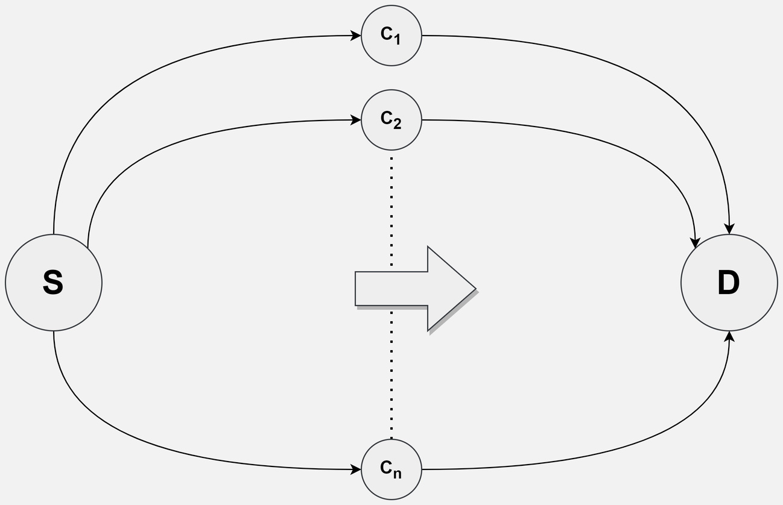
ALGORITHM
Affected PNR’s list is generated
Now List of all possible Flights is generated which has the same source or destination as of the Cancelled Flight.
Then Two Dataframes are created
which have Flights
1. Source to a connecting Airport
2. Connecting to Destination Airport

Slide 18
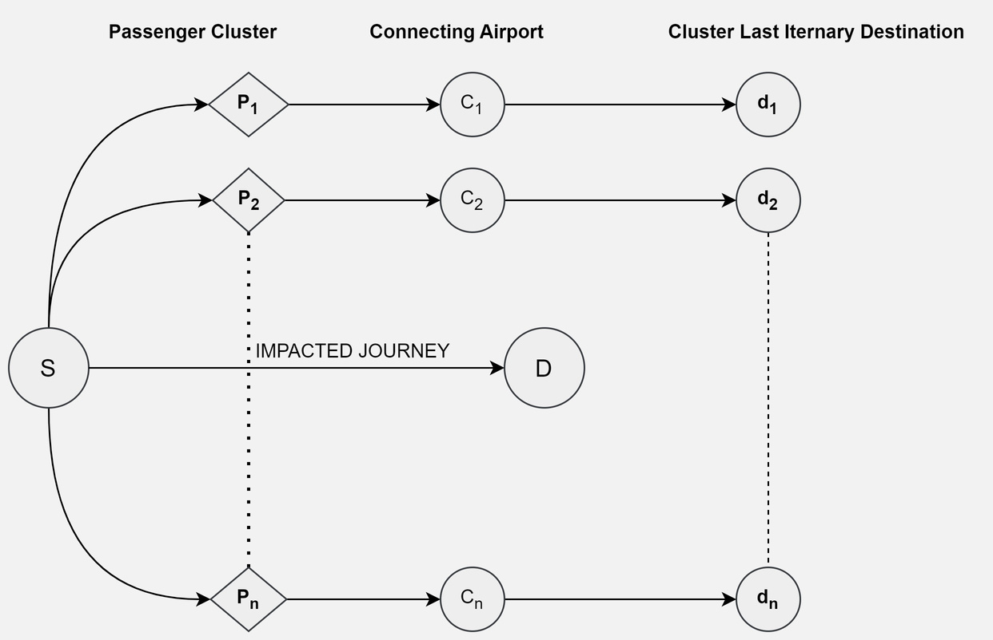
MULTI-MULTI RESCHEDULING
Approach is similar to 1-Multi scheduling
The only difference is that Destination Airport might be Different for Different
PNR

Slide 19
FUTURE APPROACH
Based on our research, we think of Implementing an Integer Linear Programming Approach. Our aim would be to minimise our Objective Function which is (Delay Cost + Downgrading Cost + Cancellation Cost.
Currently our solution is for Single Impacted only, Further our objective is to make solution for handling Multiple Impacted Flights and Schedule Changes.
Generating Solution with more than 1 connecting Flights by memoising DFS with Backtracking on Airports.

Slide 20
THANK YOU

